Slide 1
“One Person Can Make a Difference and Everyone Should Try”: An Advocacy Update
Becky Lare
Advocacy Resource Manager

Slide 2
Advocacy Capacity Grant
Advocacy Education Series
Faces of Hunger Videos
Advocacy Captains

Slide 3
Advocacy Education Series
Advocacy 101
Child Nutrition Reauthorization
Storytelling
Communicating with your Elected Officials
Notes:
137 individuals, 45 lines of credit

Slide 4
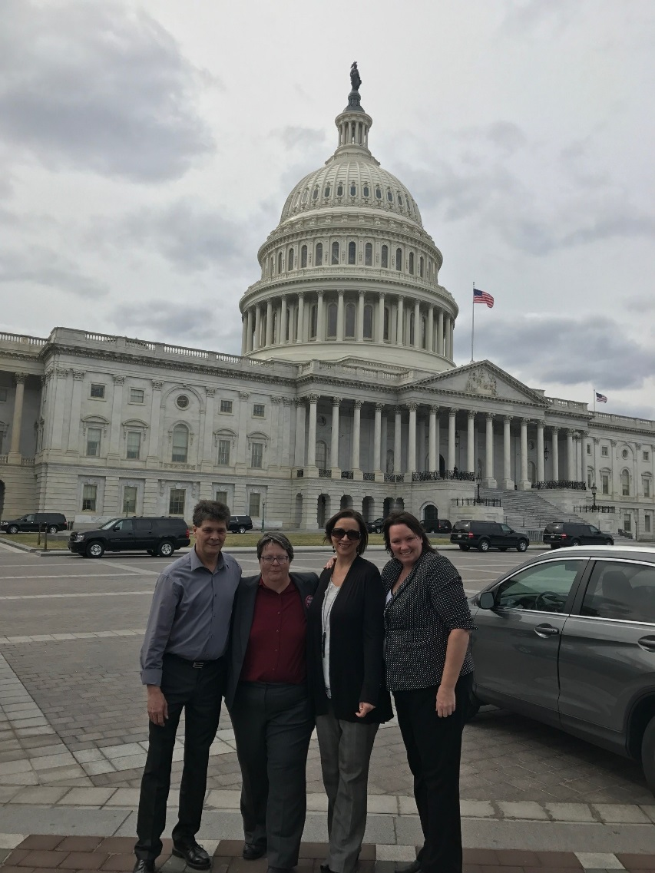
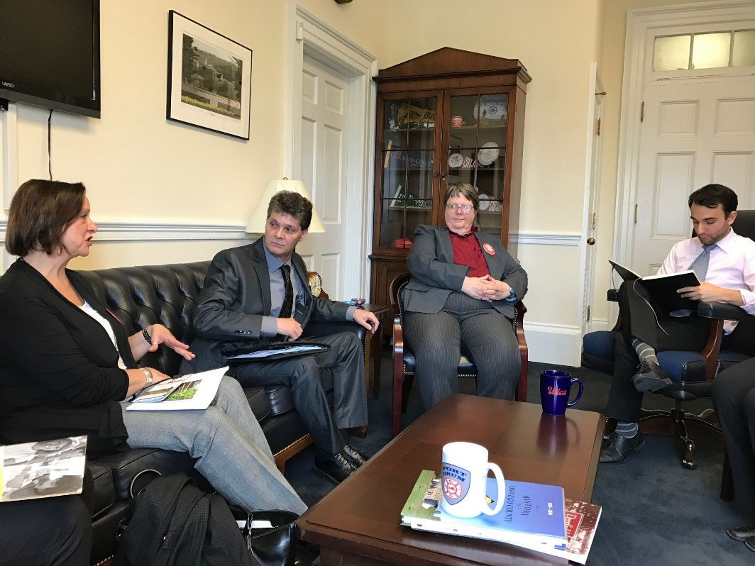
Advocacy Captains
2017 Anti-Hunger Policy Conference
Washington, D.C.

Slide 5
Federal Budget
FY17
FY18
October 1, 2016 – September 30, 2017
October 1, 2017 – September 30, 2018
Notes:
We did see some really positive things in the FY17 budget that was passed in early May
Additional $19 million in TEFAP funding
Additional $5 million in TEFAP storage & distribution funding
SNAP current caseload is funded
The administration released their full budget proposal on Tuesday, May 23
Extremely harmful to federal anti-hunger and anti-poverty programs
Please keep in mind that the President’s budget should be viewed as a messaging document and does not make changes to policies or funding levels. Such changes require legislative action. However, this is an important first step in the annual budget and appropriations process. Congress retains the power of the purse and will move forward in the summer to put together its budget proposals. We must redouble our efforts to ensure the federal nutrition safety net remains strong.

Slide 6
FY18 Budget Proposal
SNAP
$193 billion in cuts
Reduces eligibility
Shifts significant costs to states
At least 45 billion meals taken away over 10 years

Slide 7
FY18 Budget Proposal
TEFAP
$27 million in cuts to mandatory commodities
Loss of 33 million meals
$5 million in cuts to storage and distribution funds

Slide 8
Farm Bill 2018
Commodity crops and subsidies
Land conservation
International aid
Crop insurance
Agricultural Research
Nutrition
Notes:
The farm bill is the major food and farm legislation that gets revisited or reauthorized by Congress every 5 years
The next farm bill is scheduled to be reauthorized by October 2018
It sets US food and farm priorities by developing policies and funding programs that provide a safety-net for agricultural producers and for low-income Americans

Slide 9
Farm Bill 2018: Nutrition Title
SNAP
TEFAP
Food Rescue
Notes:
The farm bill dictates policy around some of the largest, most meaningful programs affecting food banks and our clients
Around 80% of farm bill funding goes to nutrition programs
SNAP
SNAP benefit levels and enrollment policies
SNAP outreach
SNAP nutrition education
SNAP Employment and Training
Other: Senior Farmers’ Markets, FINI grants, Healthy food Financing Initiative, Mobile SNAP processing, SNAP E&T Pilots, Specialty Crop Block Grant Program

Slide 10
Advocacy Opportunities
Paper Plate Project
Engaging Elected Officials
Advocacy Alerts
2017 Hunger Assessment
Notes:
As always, I’m here for you, use me as a resource
Invite your legislators for a site visit, send them your newsletter

Slide 11
Contact Information
Becky Lare
blare@foodbankcny.org
315-437-1899 x246

